Slide 1
Existential Wellbeing Counseling
Prof. Dr. Mia Leijssen
University Leuven, Belgium
Norwich Workshop
24 July 2014

Slide 2
Experiential exercise: Existential wellbeing
I will offer you a few questions so that you can capture a little bit of the salience of existential wellbeing in your life.
We start with friendly and welcoming attention in the middle of your body, giving yourself good company and listening, the same as you would give support and empathy to your best friend.

Slide 3
Visualize your life as it is for the present time and ask yourself the question:
“Who am I?”
Take notice of all possible answers that pop into you. Repeat the sentence “I am…” with several statements.
You should have at least ten statements that say something about you or what you feel like to identify with.

Slide 4
2. In what do you invest your time, energy, money ?
3. About what are you worrying in your life ?
4. What gives you joy, pleasure, happiness, peace, strength, courage in your life ?

Slide 5
Dimensions of human existence
Physical
Social
Psychological
Spiritual

Slide 6
Physical dimension

Slide 7
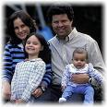
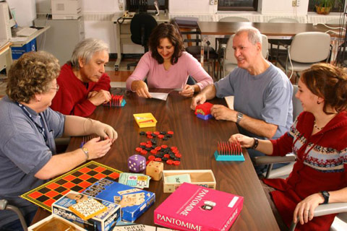
Social dimension

Slide 8
Psychological dimension

Slide 9
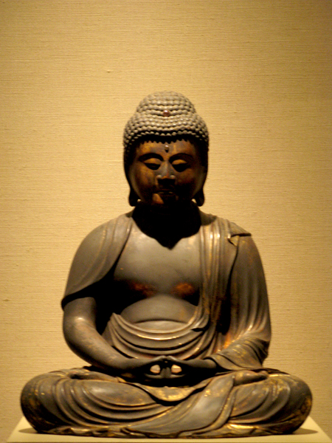
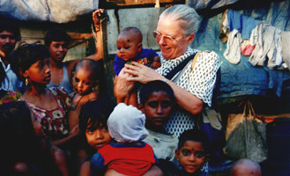
Spiritual dimension

Slide 10
Dimensions of Human Existence
 | Physical | Social | Psychological | Spiritual
Deals with I AM … | Body Material world Nature | Place in society Relations | Identity character traits Thinking and feeling | Soul Meaning Self-transcending ideals
Values ENERGY, time, money | Health Safety Comfort | Esteem, succes Connection | Autonomy Freedom Knowledge Authenticity | A better world, Consciousness of unity ‘Being values’
Threats WORRIES | Pain, sickness Death Poverty | Rejection Loliness Guilt, shame | Confusion Doubt Imperfection | Meaninglessness Futillity Evil
JOY Perenial philosophy | BEAUTY | GOODNESS | TRUTH | LOVE

Slide 11
Essential principles of existential wellbeing
Complexity of human existence: physical, social, psychological, spiritual.
Existential wellbeing implies sufficient attention for each dimension, not too much, not too little.

Slide 12
3. The starting point is experiential: focusing on the bodily felt meaning. 4. Integration of diverse humanistic/experiential theories and spiritual traditions.

Slide 13
5. Positive Psychology.
A process-oriented approach to human strengths, talents and virtues. It should not be understood as a call to ignore negative aspects of human experience. But rather how positive and negative experiences may be interrelated. Gendlin: “Every bad feeling is potential energy toward a more right way of being if you give it space to move toward its rightness."

Slide 14
“The ability of human beings to form loving bonds is possibly one of their greatest strengths.” (Aspinwall & Staudinger, 2002)

Slide 15
Example of a strenght Love = connection in different dimensions
Physical: being part of nature; respecting and enjoying the body and it’s needs; connection with the material/physical world.
Social: authentic connection with others; genuine commitment to social tasks.
Psychological: connection with oneself; self-knowlegde; self-acceptance; rich inner life.
Spiritual: connection to something that transcends the limited self; love as being.

Slide 16
Case example from psychotherapy
Performance anxiety brings a young woman to therapy. Whenever she is asked to play music in public, her hands start shaking so badly that she is no longer able to play the piano.
How can it be helpful to address different dimensions of human existence?

Slide 17
Physical dimension
We explore how in her self-experience she locks herself up in the physical dimension when she starts fearing that her hands will not be able to find the right keys.

Slide 18
Social dimension
In the social dimension she recognizes that during her childhood playing music was her way of having a relationship with her grandmother who was a musician as well. Actually she has no need whatsoever for the admiration of an audience for her musical talent.

Slide 19
Psychological dimension
In the psychological dimension she experiences music as a game in which she can fully indulge when she is alone. It is an important source of satisfaction and expression of her inner world.

Slide 20
Spiritual dimension
A dramatic change occurred when the client can experience how she would feel from a spiritual perspective if she imagined that she ‘may’ play music for an audience. She suddenly felt that the beauty of music was a divine gift that filled her with gratitude.

Slide 21
A week after this session, she reported about a performance during which she had imagined that her ‘selfless self’ was playing and singing through her.
This performance had become a peak experience during which the audience no longer appeared to be a critical judging ear, but a supporting presence.
Ever since that moment, her performance anxiety had completely disappeared.

Slide 22
Experiential exercise
Addressing a specific situation or a problem from different dimensions of human existence.

Slide 23
Thank you
Mia.leijssen@ppw.kuleuven.be

